Slide 1

The virtual, expanding world of data provided by ONEDrive
Matthew B. Jones
NCEAS, UCSB
Dave Vieglais , U. of Kansas
Roger Dahl , UNM
Ryan Kroiss , USGS
Christopher Brumgard , UT
Notes:
Virtual: there is no real drive
Expanding: data increases with nodes and content

Slide 2















DataONE Member Nodes
Today: 11 production Member Nodes
Near-term several more, e.g.:
Notes:
SEAD = Science Environment Actionable Data
EDAC = Earth Data Analysis Center

Slide 3


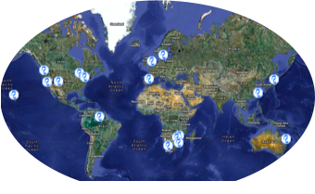
Metacat nodes around the world
Many independent repositories
DataONE ‘expands’ as these join the network
3

Slide 4
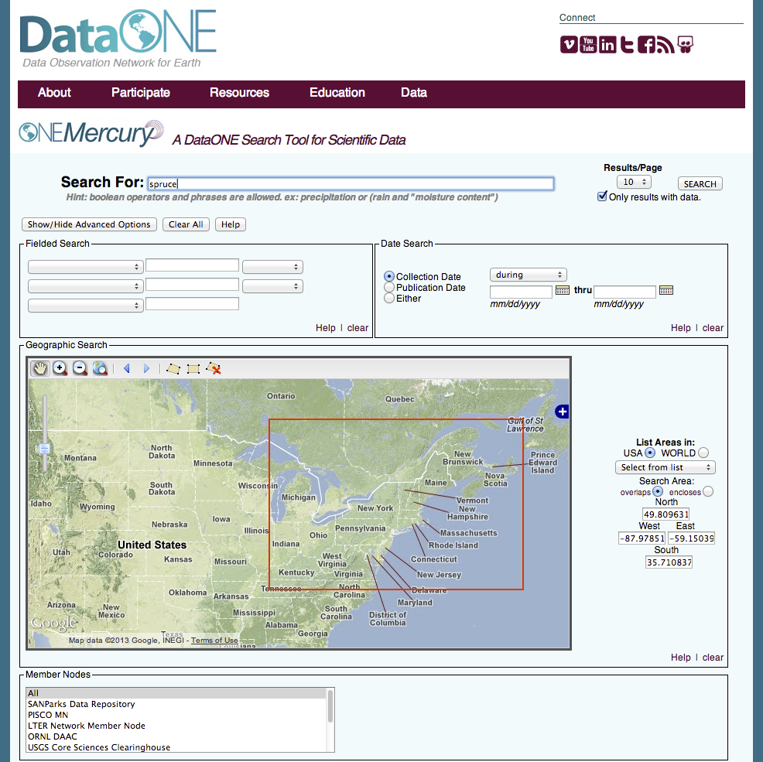
Discover
Data discovery portal
Search and retrieval of content indexed by DataONE
Collates metadata across all Member Nodes
Operates on each Coordinating Node
Notes:
Basis of content navigation is the search index. This enables selection of an interesting subset of content from the many thousands of data sets.

Slide 5


Investigator Toolkit (ITK)
ITK
Notes:
At a high level., we’ve already discussed coordinating nodes, member nodes, and the investigator toolkit.
Add “ITK” to the investigator toolkit icon
Resuse the colors to emphasize which component is the main target of the current slide / discussion.

Slide 6
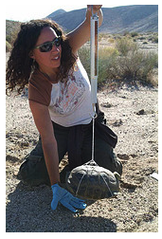
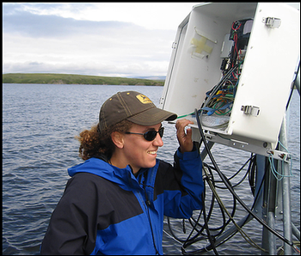
Gateway for Researchers
ITK
Notes:
At a high level., we’ve already discussed coordinating nodes, member nodes, and the investigator toolkit.
Add “ITK” to the investigator toolkit icon
Resuse the colors to emphasize which component is the main target of the current slide / discussion.

Slide 7
Tools Across the Data Life Cycle
Assure
Plan
Discover
Integrate
Analyze
Collect
Describe
Preserve
Drive
Drive
Notes:
Other development activities during years 2-5 will focus on expanding the suite of tools that are available through the Investigator Toolkit. New tool additions will be identified and prioritized by the DataONE Users Group.

Slide 8
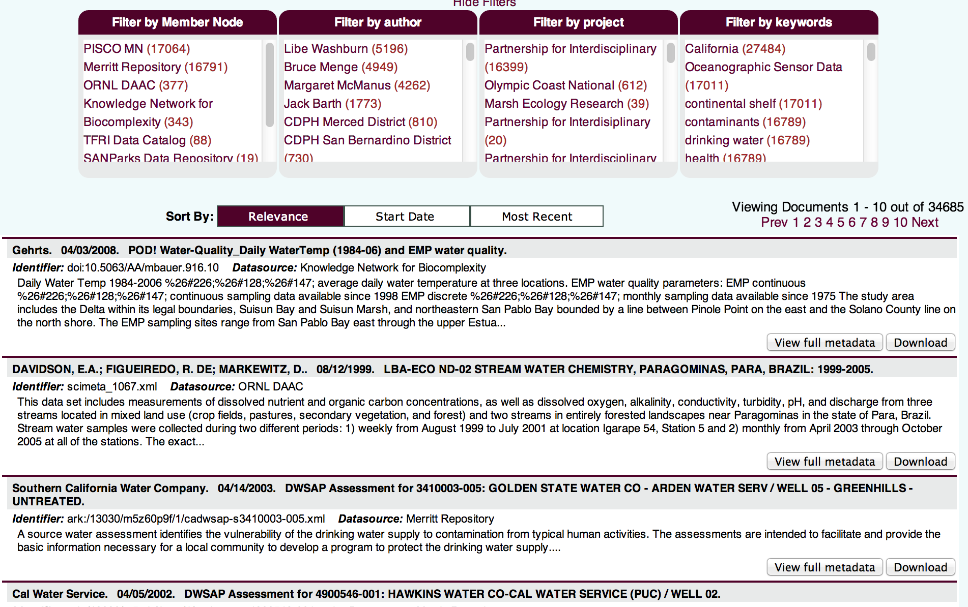
Current Workflow: manual downloads
?

Slide 9
ONEDrive Workflow
Workspace defines network drive contents
Select by specific objects or queries
Web interface to select targets, refine queries
Access content with unmodified applications
[Filters]
Network

Slide 10
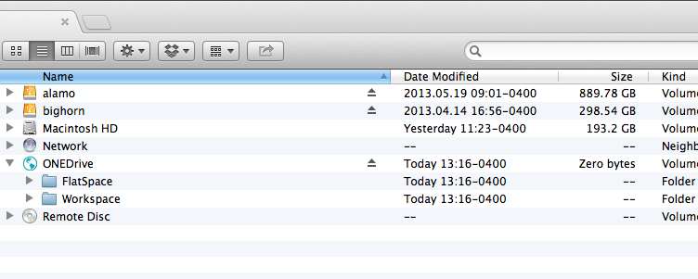
ONEDrive - root

Slide 11
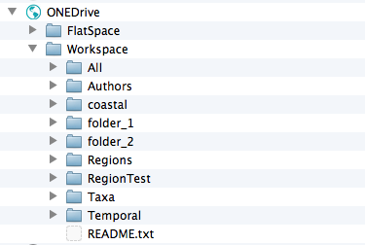
Workspace content
Predefined Views
User Defined Folders

Slide 12
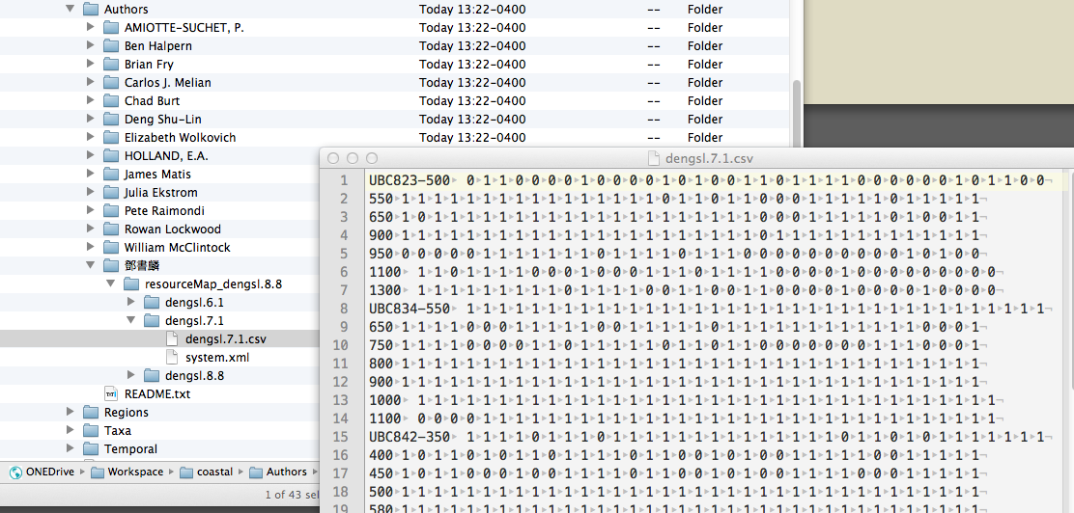
Data and metadata directly browsable

Slide 13
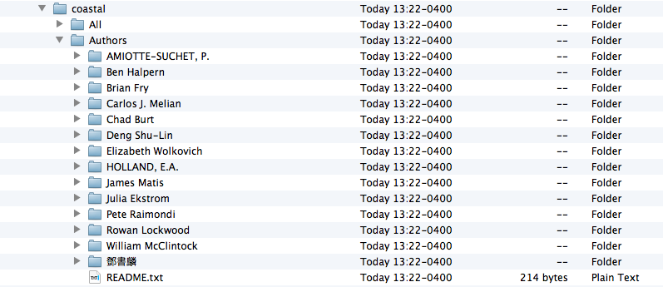
Author List

Slide 14
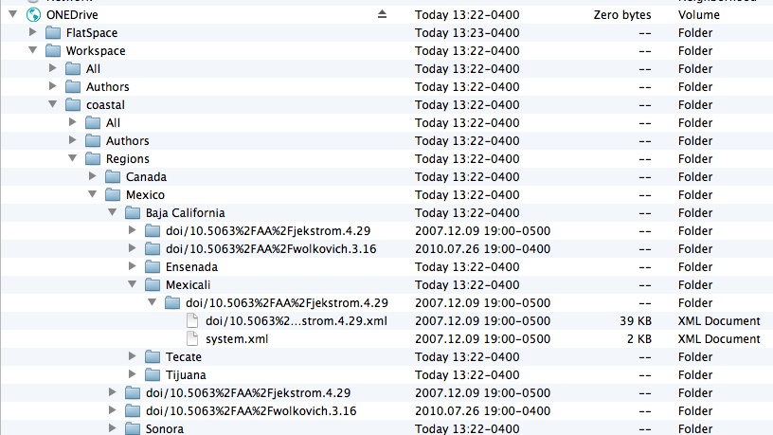
Regional Hierarchy

Slide 15
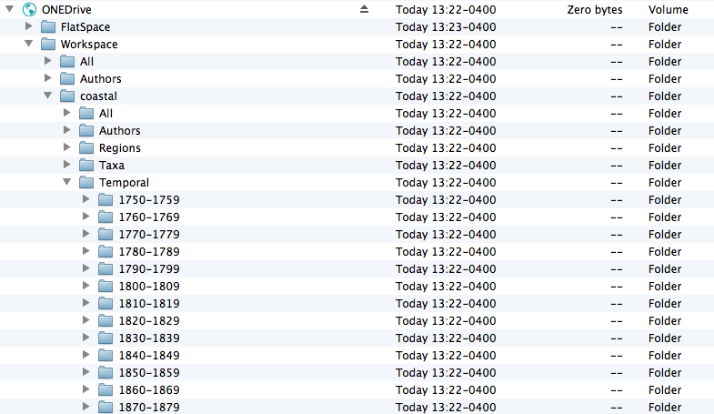
Temporal Coverage

Slide 16
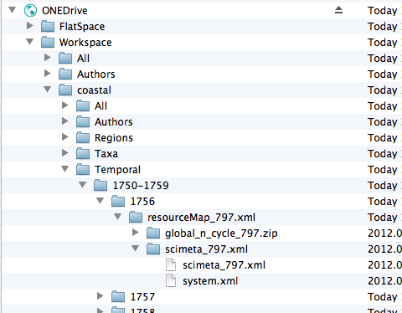
Temporal Coverage

Slide 17
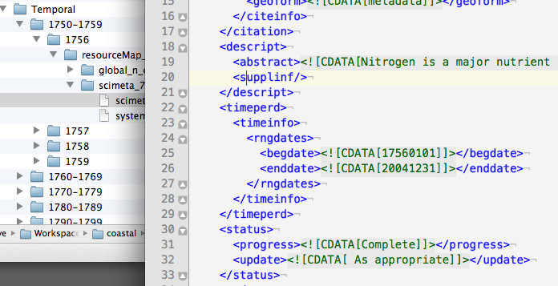
Temporal Coverage

Slide 18
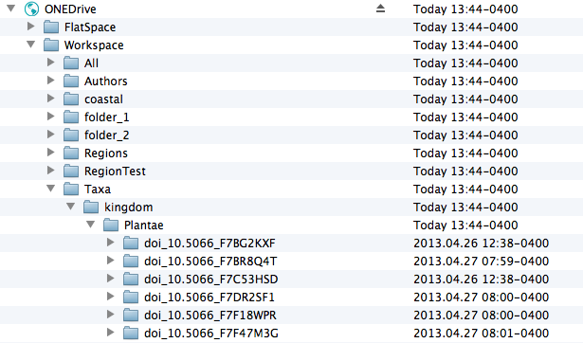
Taxonomic Hierarchy

Slide 19
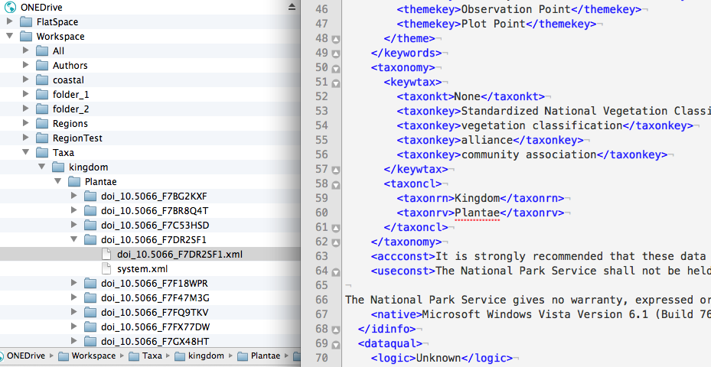
Taxonomic Hierarchy

Slide 20
ONEDrive: Next Steps
Three main focus areas:
Refine the content views
Improve client side rendering of results
Augment search index (e.g. taxonomic, spatial)
Utilize external services for lookups
Add Drag’n’Drop write support
Upload content to Member Nodes

